Slide 1
Welcome to MY qUIZ Minor Project
Under guidance of: Sunil Kumar
Dept.Name: Computer Science and Engineering.
Inst: M.M.I.T. Aligarh.
Yogesh Kumar ,Shyam verma, Amit kumar ,Shashikant Chodhary , Sweta Soni , Rimjhim Varshney

Slide 2
The Project is divided into three Portion
Admin Zone
Teacher Zone
Student Zone

Slide 3
Admin Zone
Can check the students.
Can check the running test.
Teacher
Can create quiz after logged in.
Can enter subjects and enter question with its options and answer at the time of creating quiz.
Student
Can search quiz according to their interest.
ready to start it just clicking on a button.
Can check the how many students attend the test.
Can add a staff.
Can check staff members.
10 Question for each quiz required to be completed.
After completing all questions, result will be displayed automatically and also send to the email account.

Slide 4
Non Functional Requirements
Secure access of confidential data (user?s details). SSL can be used.
24 X 7 availability
Browser testing and support for IE, NN, Mozila, and Firefox
Reports exportable in .XLS, .PDF .
Create a detailed UML diagram (Component, Sequence, Class) for the system and its sub-components.

Slide 5
User Interface Priorities
Professional look and feel
Use of AJAX at least with all registration forms and with every search option and at the id of each searched result with on mouse over event.

Slide 6
Tools to be used
Use any IDE to develop the project. It may be Visual Studio.
My SQL for the database.
Server: Apache Tomcat/JBoss/Glassfish/Weblogic/Websphere

Slide 7
Front End and Back End
Front End: Javascript, AJAX ,MPDF.
Back End: My SQL , PHP.

Slide 8
Software Requirement to run this project
You need to install an IDE Eclipse / Myeclipse / Netbeans.
My SQL database. Here, we are using root for the username and “” for the password.

Slide 9
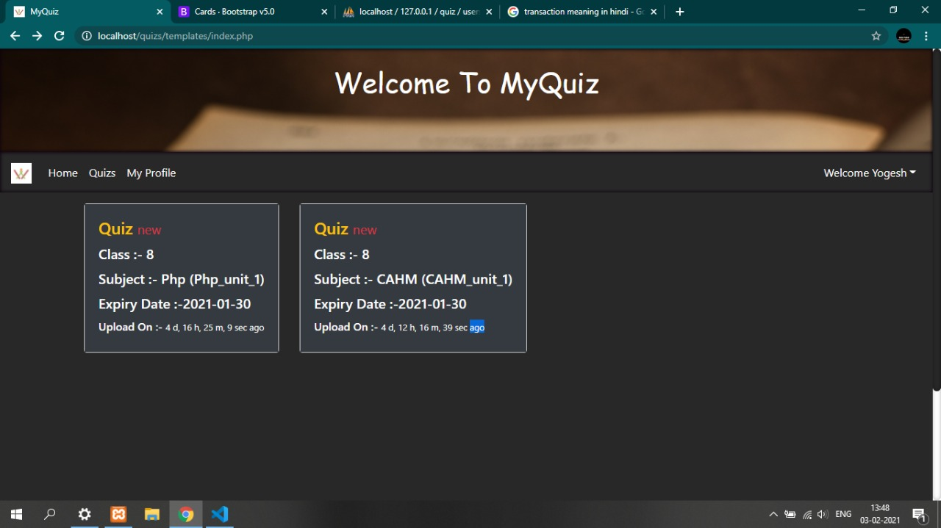
Welcome Page

Slide 10
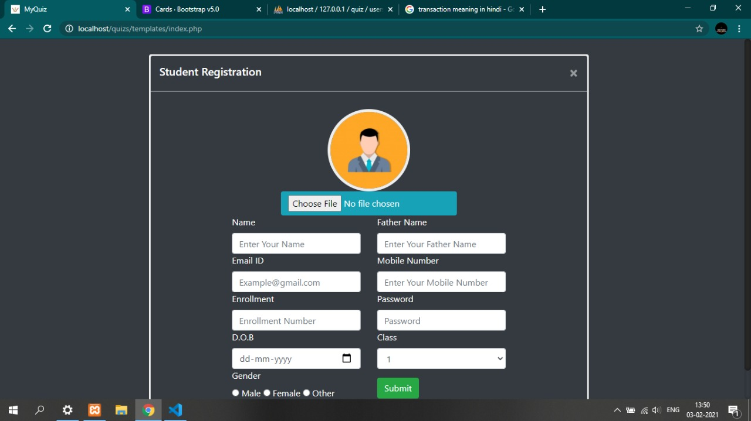
Registeration

Slide 11
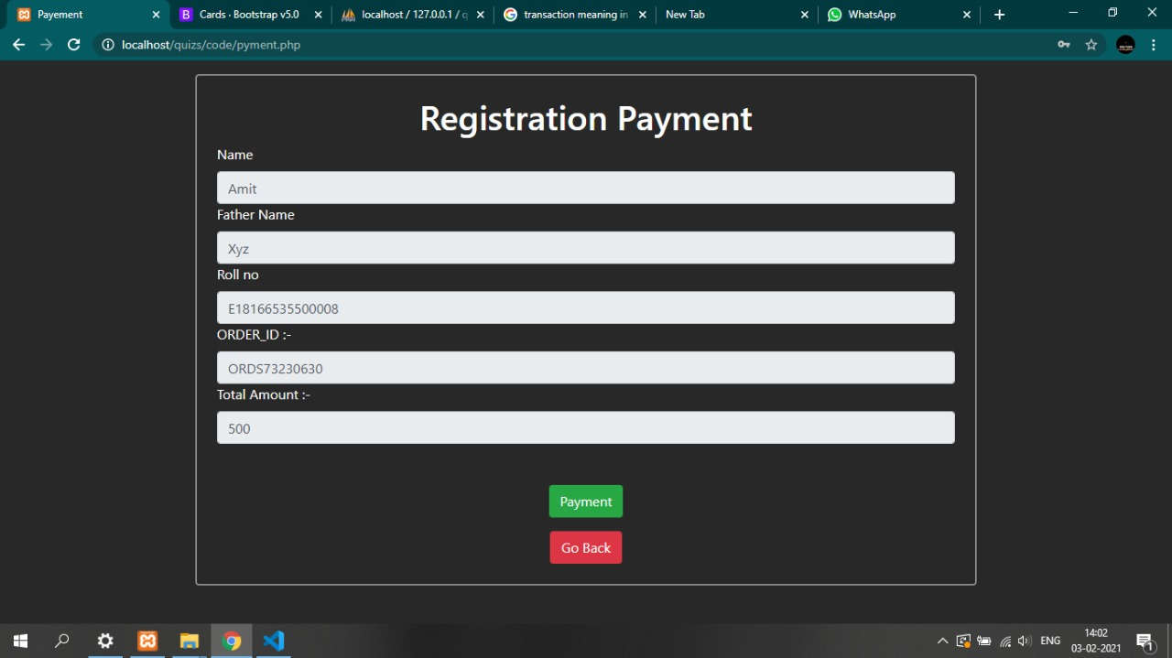
Registration Payment

Slide 12
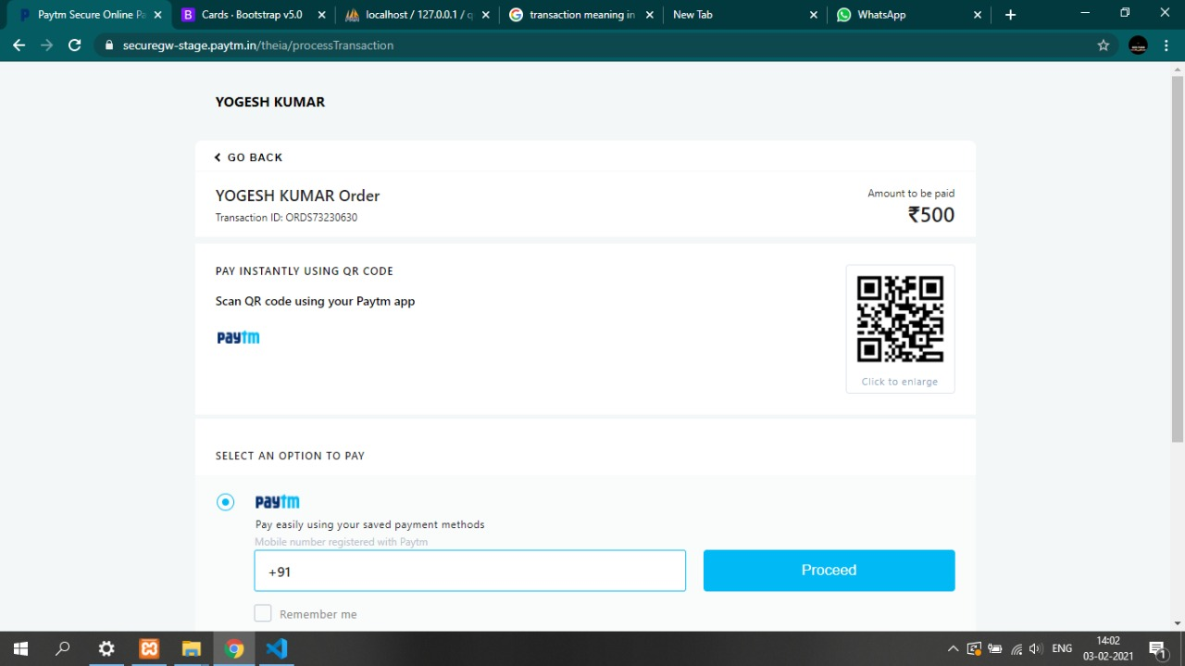
Registration Payment

Slide 13
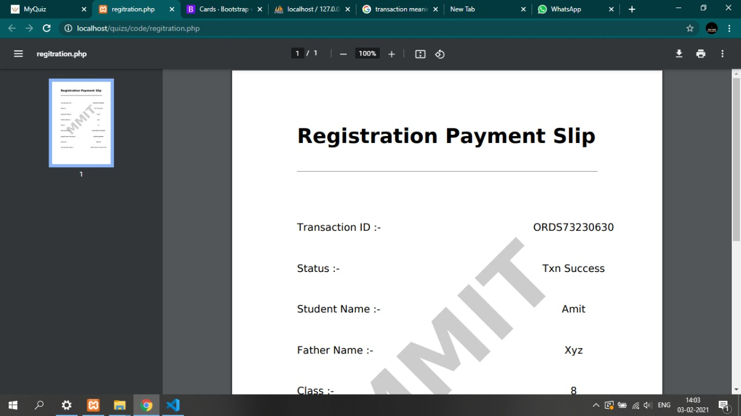
Registration Payment Slip

Slide 14
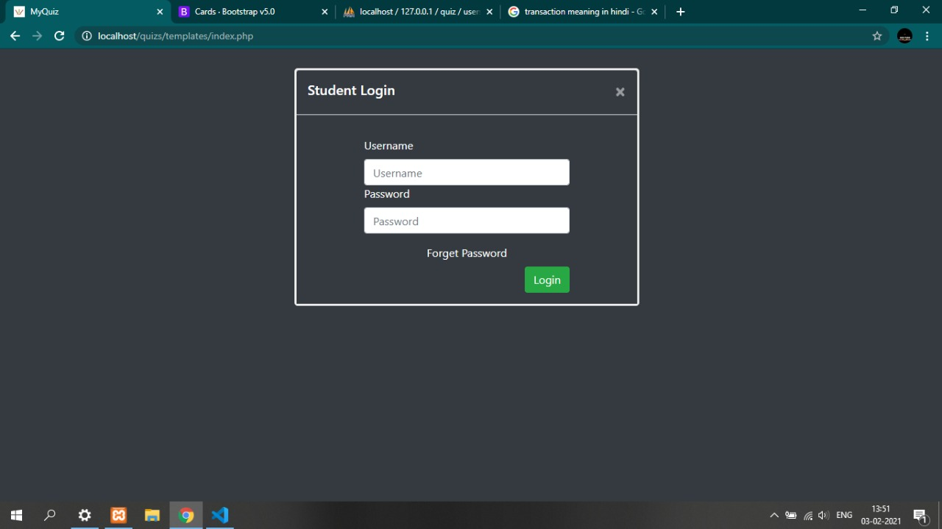
Login

Slide 15
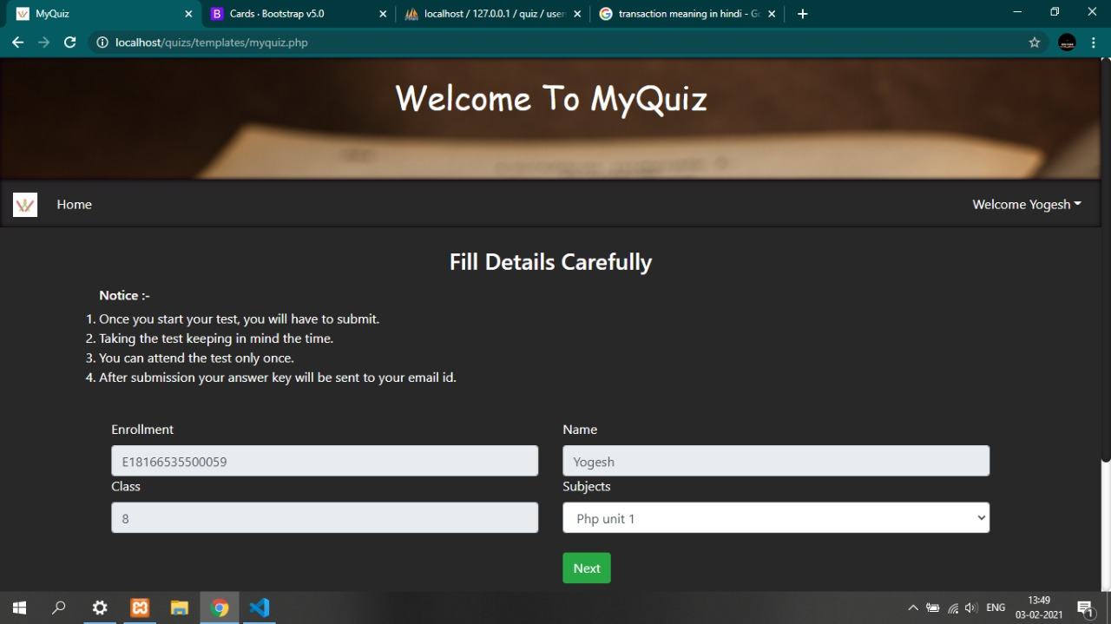
Selecting Test

Slide 16
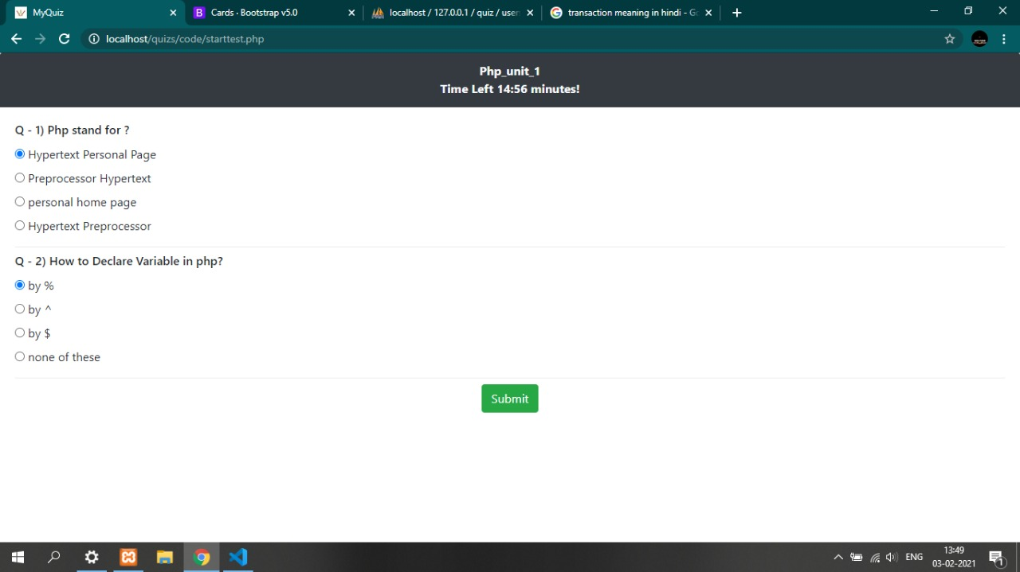
During the Test

Slide 17
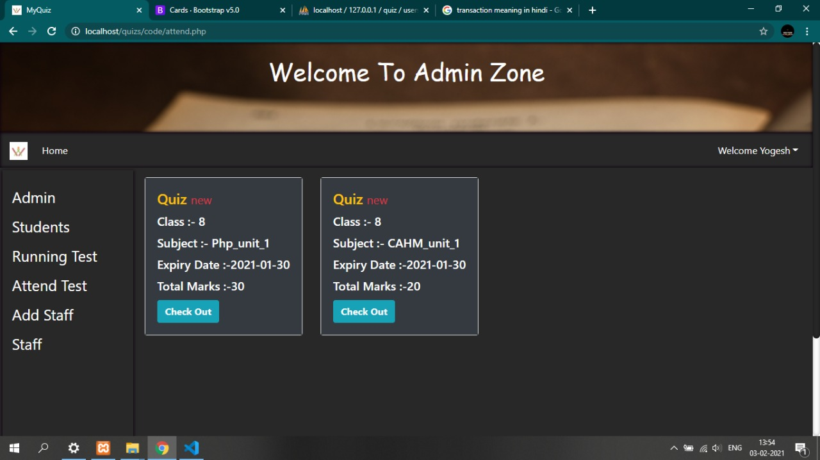
Admin Zone

Slide 18
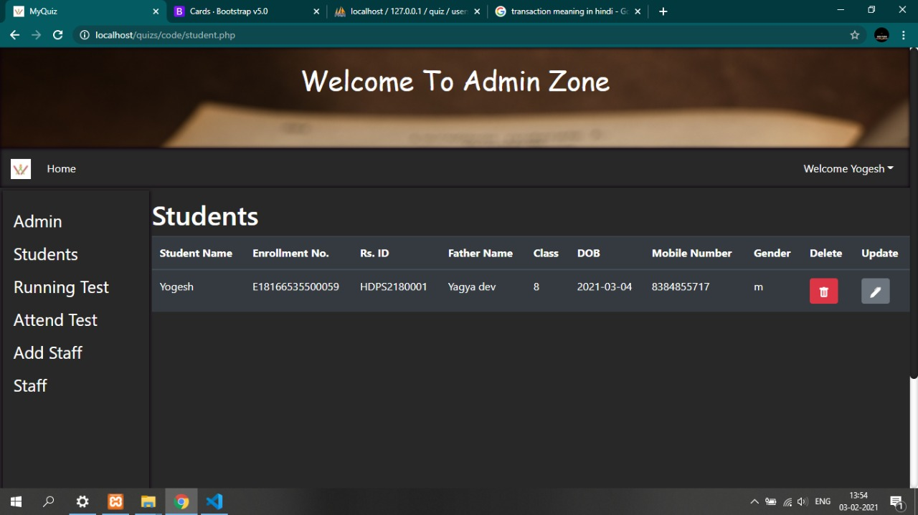
Student List

Slide 19
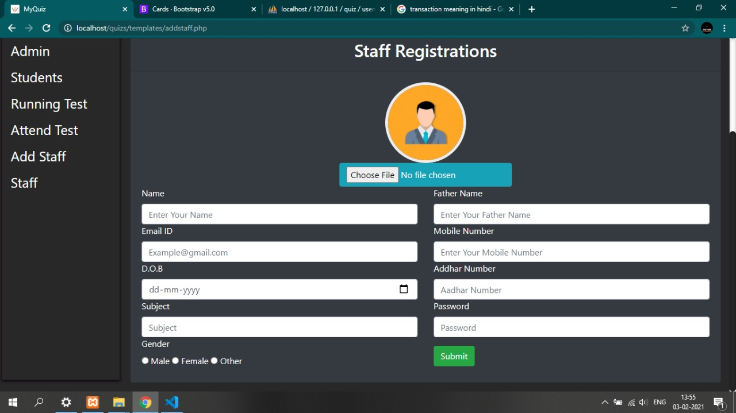
Staff Registration

Slide 20
Thanks You for giving your valuable Time

